Slide 1
Hamiltonian Chaos and the Ergodic Hypothesis
The Brown Bag
Hassan Bukhari
BS Physics 2012
墫鱡뱿轺

Slide 2
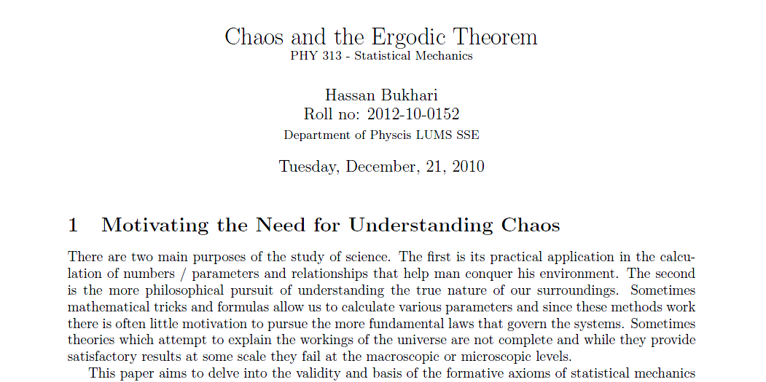
Stat Mech Project
“It is not less important to understand the foundation of such a complex issue than to calculate useful quantities”

Slide 3
Over View
What is the Ergodic Hypothesis
What is Chaos
How can these two concepts meet

Slide 4
Ergodic Theory
Under certain conditions, the time average of a function along the trajectories exists almost everywhere and is related to the space average
In measure theory, a property holds almost everywhere if the set of elements for which the property does not hold is a null set, that is, a set of measure zero
Notes:
rgodic theory is a branch of mathematics that studies dynamical systems with an invariant measure and related problems. Its initial development was motivated by problems of statistical physics.
A central aspect of ergodic theory is the behavior of a dynamical system when it is allowed to run for a long time. The first result in this direction is the Poincaré recurrence theorem, which claims that almost all points in any subset of the phase space eventually revisit the set. More precise information is provided by various ergodic theorems which assert that, under certain conditions, the time average of a function along the trajectories exists almost everywhere and is related to the space average. Two of the most important examples are ergodic theorems of Birkhoff and von Neumann. For the special class of ergodic systems, the time average is the same for almost all initial points: statistically speaking, the system that evolves for a long time "forgets" its initial state. Stronger properties, such as mixing and equidistribution, have also been extensively studied.

Slide 5
Qualitative proof
The phase trajectories of closed dynamical systems do not intersect.
By assumption the phase volume of a finite element under dynamics is conserved.
A trajectory does not have to reconnect to its starting point. A dense mix of trajectories. Eg harmonic oscillator

Slide 6
In mathematics, the term ergodic is used to describe a dynamical system which, broadly speaking, has the same behavior averaged over time as averaged over space.
In physics the term is used to imply that a system satisfies the ergodic hypothesis of thermodynamics.

Slide 7
Mathematical Interpretations
Birkhoff–Khinchin

Slide 8
The Ergodic Hypothesis
Over long periods of time, the time spent by a particle in some region of the phase space of microstates with the same energy is proportional to the volume of this region, i.e., that all accessible microstates are equiprobable over a long period of time.
Notes:
More precise information is provided by various ergodic theorems which assert that, under certain conditions, the time average of a function along the trajectories exists almost everywhere and is related to the space average.

Slide 9
Chaos

Slide 10
The Logistic map

Slide 11
Deterministic Chaos

Slide 12
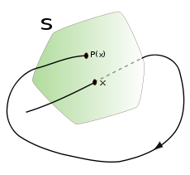
Poincare Sections

Slide 13
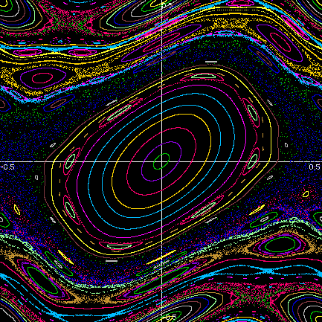
The Standard Map
p_{n + 1} = p_{n} + Ksin(θ_{n})
θ_{n + 1} = θ_{n} + p_{n + 1}
p – θ plane

Slide 14
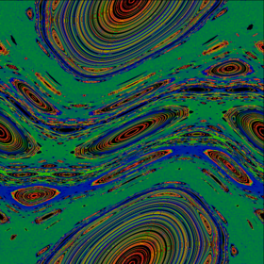
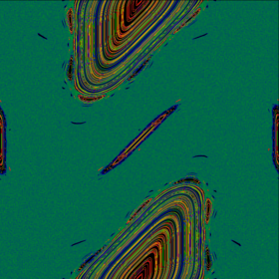
K = 0.6 K = 0.9 K = 1.2
K = 2.0
p_{n + 1} = p_{n} + Ksin(θ_{n})
θ_{n + 1} = θ_{n} + p_{n + 1}

Slide 15
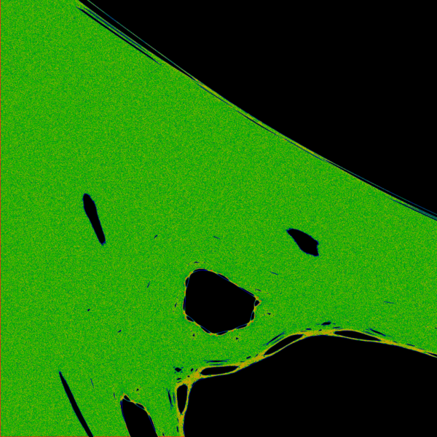
Close up of the chaotic region

Slide 16
Integrable Hamiltonian’s
This will evolved around an n-d torus
Pertubed Hamiltonians were shown to be non-integrable
Non- integrable meant ergodic

Slide 17
KAM Theorem and KAM Tori
If the system is subjected to a weak nonlinear perturbation, some of the invariant tori are deformed and survive, while others are destroyed
Oh no! What becomes of the Ergodic Hypothesis!
Notes:
The KAM theorem is usually stated in terms of trajectories in phase space of an integrable Hamiltonian system. The motion of an integrable system is confined to a doughnut-shaped surface, an invariant torus. Different initial conditions of the integrable Hamiltonian system will trace different invariant tori in phase space. Plotting any of the coordinates of an integrable system would show that they are quasi-periodic.

Slide 18
The FPU Problem – A lucky simulation
N masses connected with non-linear springs
What does statistical mechanics predict will happen
What do you expect will happen?

Slide 19
Solving the Problem
FPU (Fermi – Pasta – Ulam) problem
%% initialization
N=32; % Number of particles must be a power of 2
alpha= 0.25; % Nonlinear parameter
totalt=500000; dt=20; % totalt and Delta t
tspan=[0:dt:totalt];
options=odeset('Reltol',1e-4,'OutputSel',[1,2,N]);
%% initial conditions for normal modes
for I=1:N,
a=10;
b(I)=a*sin(pi*I/(N+1));
b(I+N)=0; % initial conditions
omegak2(I)=4*(sin(pi*I/2/N))^2; % Mode Frequencies
end
[T,Y]=ode45('fpu1',tspan,b',options,N); % t integration
for IT=1:(totalt/dt),
t(IT)=IT*dt*sqrt(omegak2(1))/2/pi; % t iteration loop
YX(IT,1:N+1)=[0 Y(IT,1:N )];
YV(IT,1:N+1)=[0 Y(IT,N+1:2*N )];
sXF(IT,:)= imag(fft([YX(IT,1:N+1) 0 -YX(IT,N+1:-1:2)]))/sqrt(2*(N+1));
sVF(IT,:)= imag(fft([YV(IT,1:N+1) 0 -YV(IT,N+1:-1:2)]))/sqrt(2*(N+1));
Energ(IT,1:N)=(omegak2(1:N).*(sXF(IT,2:N+1).^2)+sVF(IT,2:N+1).^2)/2;
end
% figure
% plot(t,Energ(:,1),'r-',t,Energ(:,2),t,Energ(:,3),t,Energ(:,4),'c-');

Slide 20
function dy=fpu1(t,y)
N=32;alpha=0.25;
D(N+1)=y(2) -2*y(1)+alpha*((y(2)-y(1))^2-y(1)^2);D(1)=y(N+1);
D(2*N)=y(N-1)-2*y(N)+alpha*(y(N)^2-(y(N)-y(N-1))^2);D(N)=y(2*N);
for I=2:N-1,
D(N+I)=y(I+1)+y(I-1)-2*y(I)+alpha*((y(I+1)-y(I))^2-(y(I)-y(I-1))^2);
D(I)=y(N+I);
end
dy=D';
for IT= 1:(25000)
avg(IT) = sum(Energ(1:IT,1))/IT/10;
avg2(IT) = sum(Energ(1:IT,2))/IT/10;
avg3(IT) = sum(Energ(1:IT,3))/IT/10;
avg4(IT) = sum(Energ(1:IT,4))/IT/10;
avg5(IT) = sum(Energ(1:IT,5))/IT/10;
avg6(IT) = sum(Energ(1:IT,6))/IT/10;
avg7(IT) = sum(Energ(1:IT,7))/IT/10;
avg8(IT) = sum(Energ(1:IT,8))/IT/10;
end
figure
plot(log(1:25000),avg,log(1:25000),avg2,log(1:25000),avg3,log(1:25000),avg4,log(1:25000),avg5,log(1:25000),avg6,log(1:25000),avg7,log(1:25000),avg8)
hold on

Slide 21
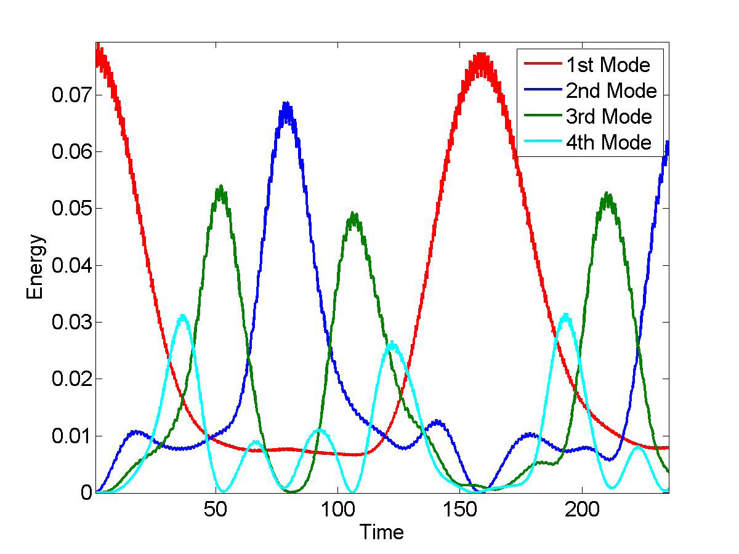
Results

Slide 22
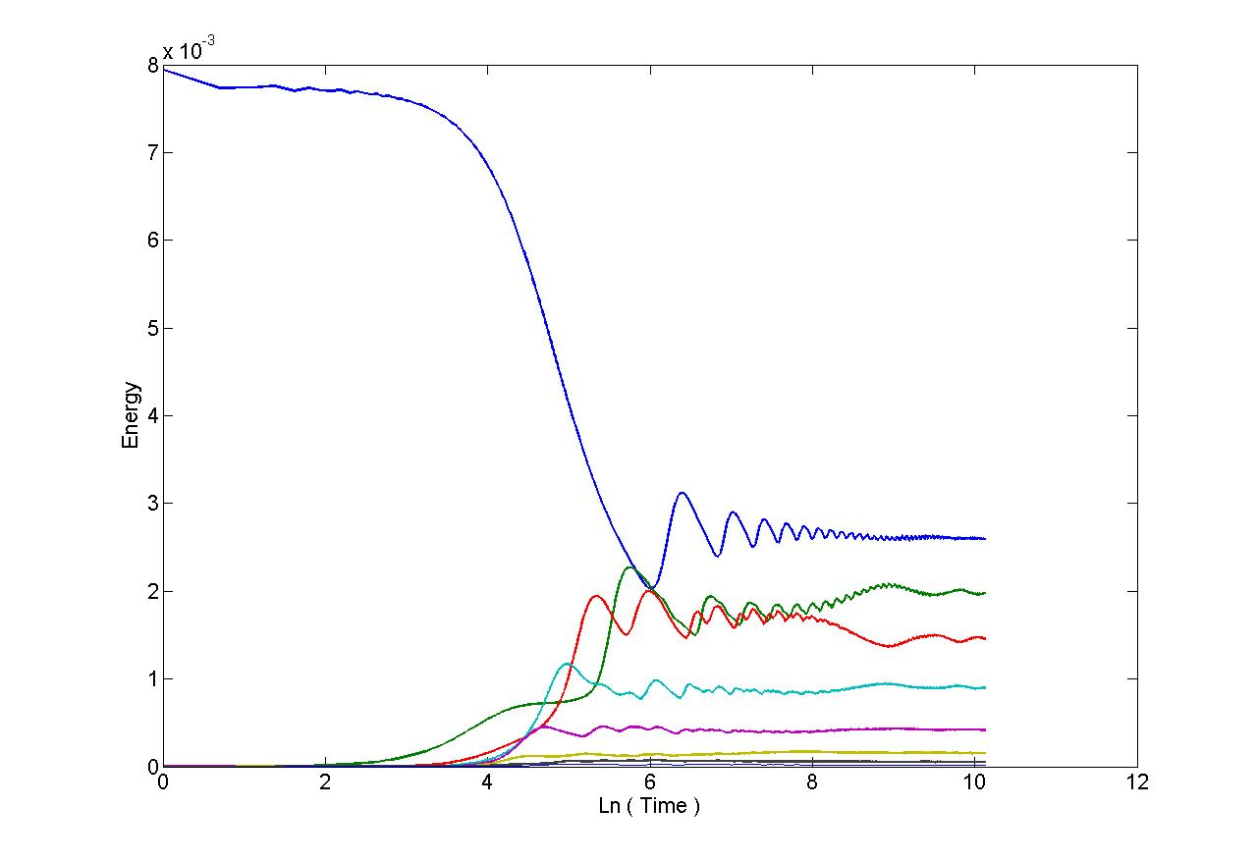

Slide 23
Invariant Tori!
Looks like we have chosen initial conditions which are on some Tori that has survived.
Increase the non-linearity?
Non-linearity is a characteristic of the system.
Energy Density = E_{total}/N

Slide 24
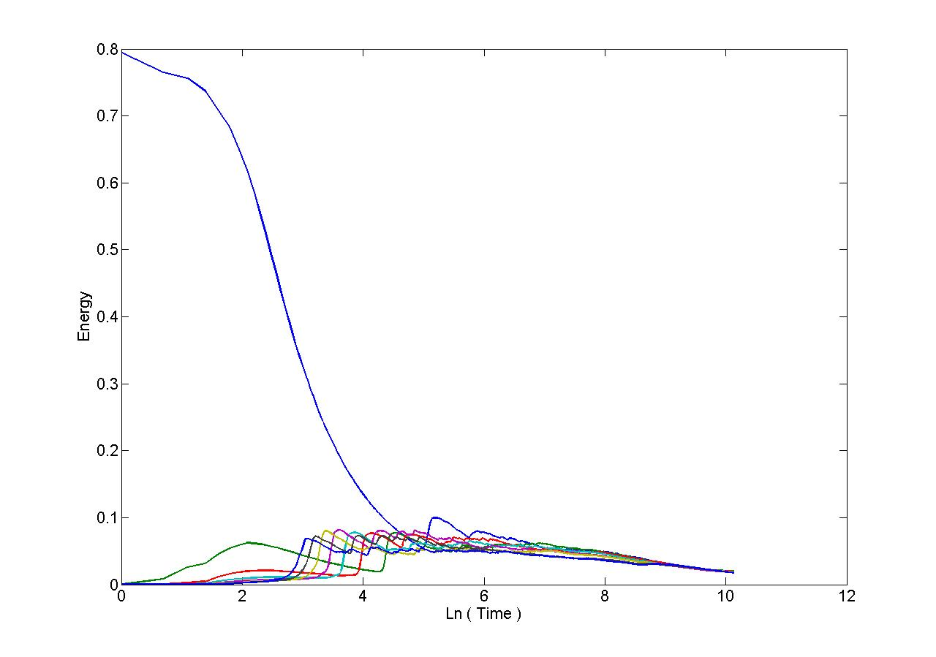
Equipartition

Slide 25
Energy Density
E_{total}/N
Every ε_{c} has a corresponding critical Energy density
Increased E.

Slide 26
Conclusions
Presence of Chaos is an insufficient condition
If ε < ε _{c} then the KAM tori are still dominant and the system will not reach equipartition
As N → ∞ then E_{total}/N → 0 and so any initial energy will go to equipartition
Notes:
Have taken the dynamics into account in this derivation

